Slide 1

Predicting Customer Spend & Subscription
(2024-2025)

Slide 2
Content
Business Case – To build predictive models that identify key customer characteristics in order to forecast Average Monthly Spend and the likelihood of an eBook Subscription.
Data Acquisition – Customer demographic and transactional data was obtained in CSV format from the internal database.
Data Preparation – The dataset was cleaned and processed. This included splitting combined location data into separate features (City, ZipCode, State) and deriving Age from birth dates.
Data Visualization – Tableau was used to create a series of graphs to visually explore the relationships between customer attributes and the target variables.

Slide 3
Data Preparation
Total number of records = 16,518
No duplicate customer records were found.
The City-ZipCode-State column was successfully parsed into three separate, usable features.
Missing Values Treatment:
The following columns were removed from the dataset due to a high proportion of missing or irrelevant information:
  Title
  Middle Name
  Suffix
  Street Address2
This cleaning step ensures the quality and integrity of the data used for modeling.

Slide 4
Exploratory Data Analysis
The features (variables) are segregated into categories to define their role in the predictive models:
Dependent Variables (Y) – These are the two target values we aim to predict:
  Avg Monthly Spend (A continuous value for regression)
  eBook Subscriber Flag (A binary outcome for classification: Yes/No)
Noise / Identifier Features – Variables excluded from the models as they offer no predictive power, are identifiers, or contain excessive missing data:
  Customer ID, First Name, Middle Name, Last Name, Title, Suffix, Street Address1, Street Address2
Redundant Features – Variables that were transformed and are no longer needed:
  City-ZipCode-State (Replaced by individual columns)
  Birth Date (Replaced by calculated Age)
Predictor Variables – The key customer attributes used to train the models.

Slide 5
Exploratory Data Analysis (contd..)
Noise & Missing Data Variables
Predictor Variables
Customer ID
First Name
Middle Name
Last Name
Title
Suffix
Street Address1
Street Address2
Birth Date
City-ZipCode-State
City | Number of Cars Owned
State | Number of Children At Home
ZipCode | Total Number of Children
Age (derived) | Annual Income
Education Level
Occupation
Gender
Marital Status
Home Owner Status

Slide 6
Data Visualization
Data visuals were created using Tableau. Charts were plotted using the predictor variables against each of the two dependent variables (Avg Monthly Spend and eBook Subscriber Flag).
These charts provide a clear, preliminary understanding of the key customer segments and behaviors, guiding the feature selection for our machine learning models. The following slides highlight the most significant findings.

Slide 7
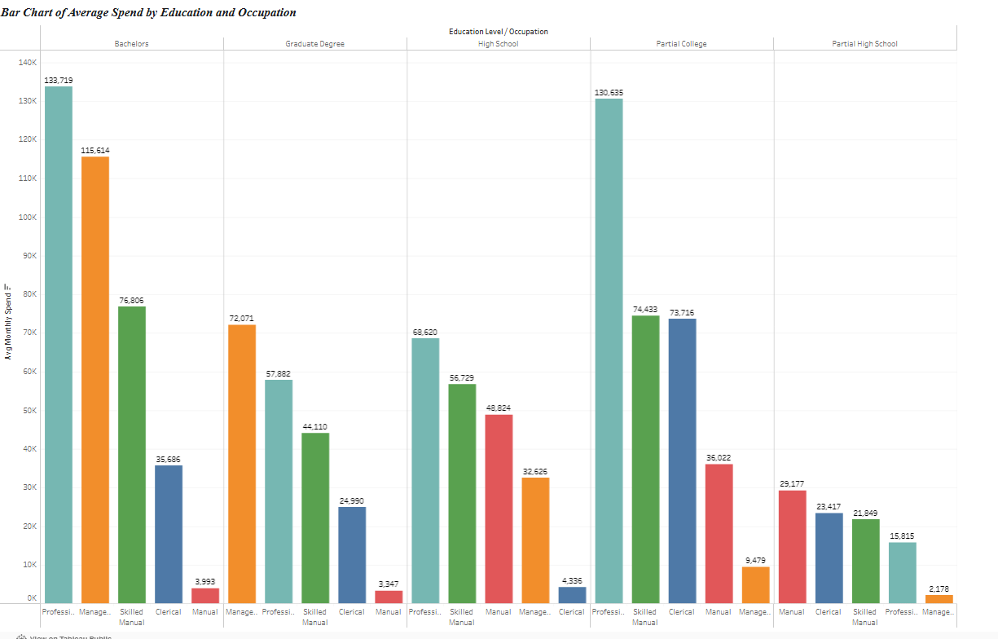
Who Are Our Highest-Spending Customers?
Key Highlights
Education is a primary driver of spending. Customers with a Bachelor' s degree are the highest spending segment (133k),followed closely by those with a PartialCollege education(133k).
Occupation amplifies this effect. Within these top educational tiers, individuals in Professional roles consistently demonstrate the highest purchasing power.

Slide 8
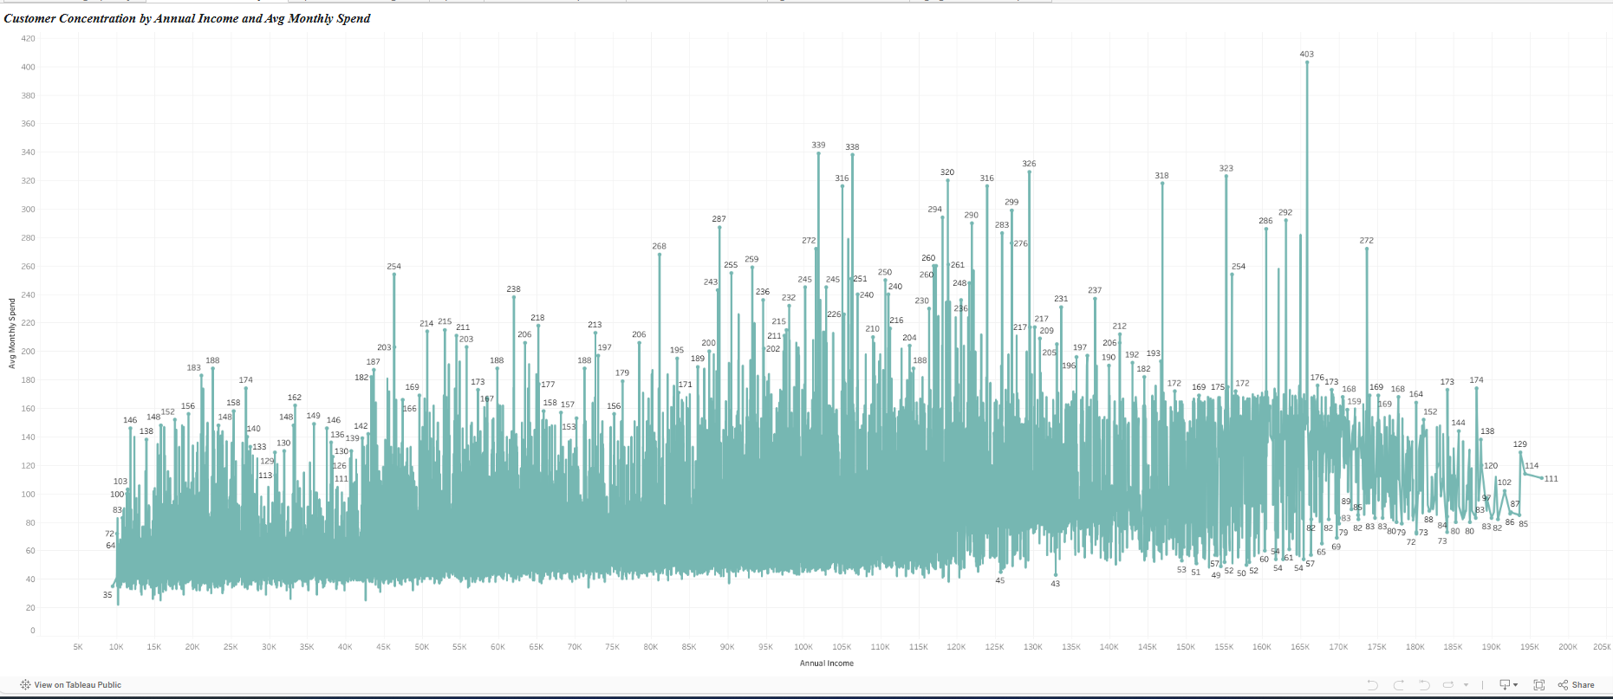
What Financial Factors Trigger High Spending?
Key Highlights
There is a direct and strong correlation between annual income and monthly spend.
A critical income threshold exists around $85,000 - $90,000. Customers who cross this line are responsible for the majority of spending above $200
This insight is crucial for identifying high-value customer acquisition targets.

Slide 9
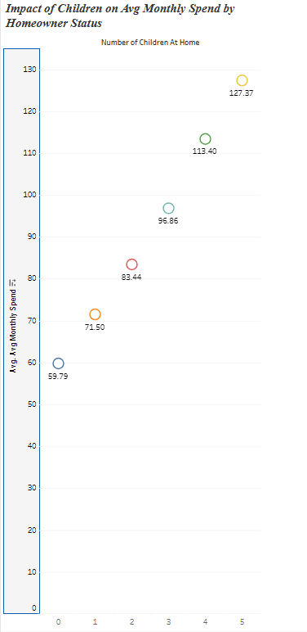
How Does Family Structure Impact Spending?
Key Highlights
Spending increases linearly with the number of children.
Customers with 0 children have the lowest average spend(60),while those with 5 children have the highest (127).
Each additional child consistently adds to the monthly expenditure, making "Total Number of Children" a powerful predictive feature.

Slide 10
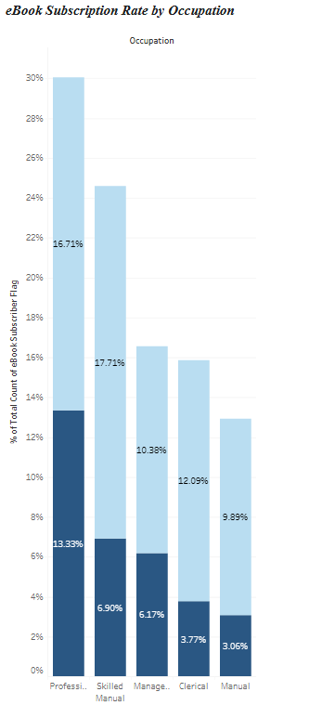
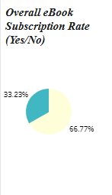
What is the Profile of an eBook Subscriber?
Key Highlights
eBook subscription is a niche behavior: only 33% of customers are subscribers.
This service overwhelmingly appeals to one group: Professionals, who make up 13.13% of all subscribers, nearly double the next closest group (Skilled Manual at 6.9%).
This allows marketing efforts to be highly targeted toward specific occupational segments.

Slide 11
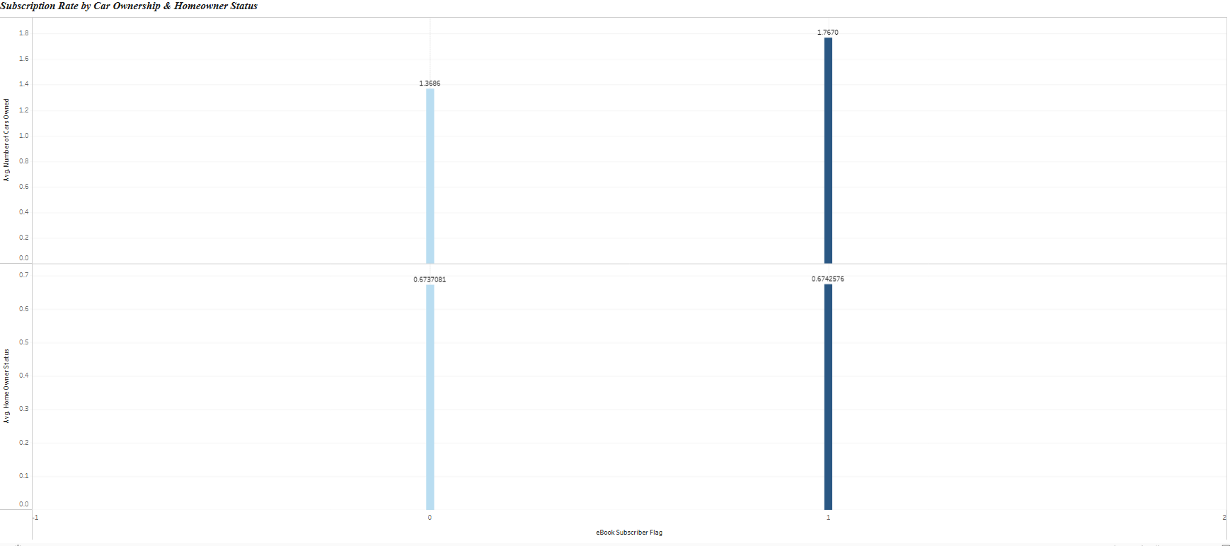
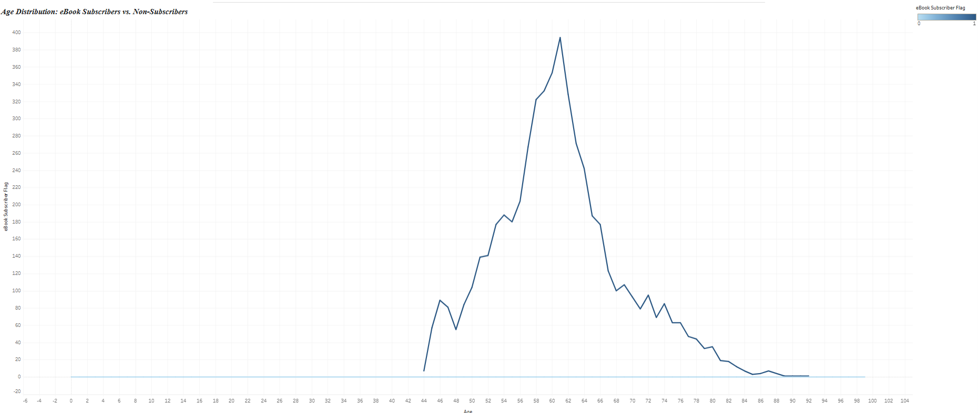
What Age and Lifestyle Define a Subscriber?
Key Highlights
Age is a defining factor. Subscription rates see a sharp increase starting at age 46, with the core subscriber base concentrated between 50 and 70 years old.
Subscribers tend to have a stable lifestyle. On average, they are homeowners and own more cars than non-subscribers (1.76 vs 1.3), indicating a specific life stage and level of financial stability.

Slide 12
Key Predictive Features & Model Performance
      Significance and Correlations Analysis was performed to identify list of features which impact the std score
Top 3 Features Impacting Avg Monthly Spend
1. Annual Income
2. Total Number of Children
3. Occupation
Top 3 Features Impacting eBook Subscription
1. Age
2. Occupation
3. Number of Cars Owned
Model Performance:
Following this analysis, two machine learning models were successfully built. Both the regression model for spending and the classification model for subscriptions demonstrate strong predictive performance. They are capable of accurately forecasting customer behavior, providing a solid, data-driven foundation for strategic business decisions

Slide 13
Questions?

